Slide 1
In order to access Twitter data, you need to have a valid Twitter account and you need to obtain your “API keys” and “Access Tokens.”
First, open an account at twitter.com and validate it with your phone. If you already have an account, but it is not validated with a phone, you need to validate it (see https://support.twitter.com/articles/110250
The following slides include screenshots of the process

Slide 2
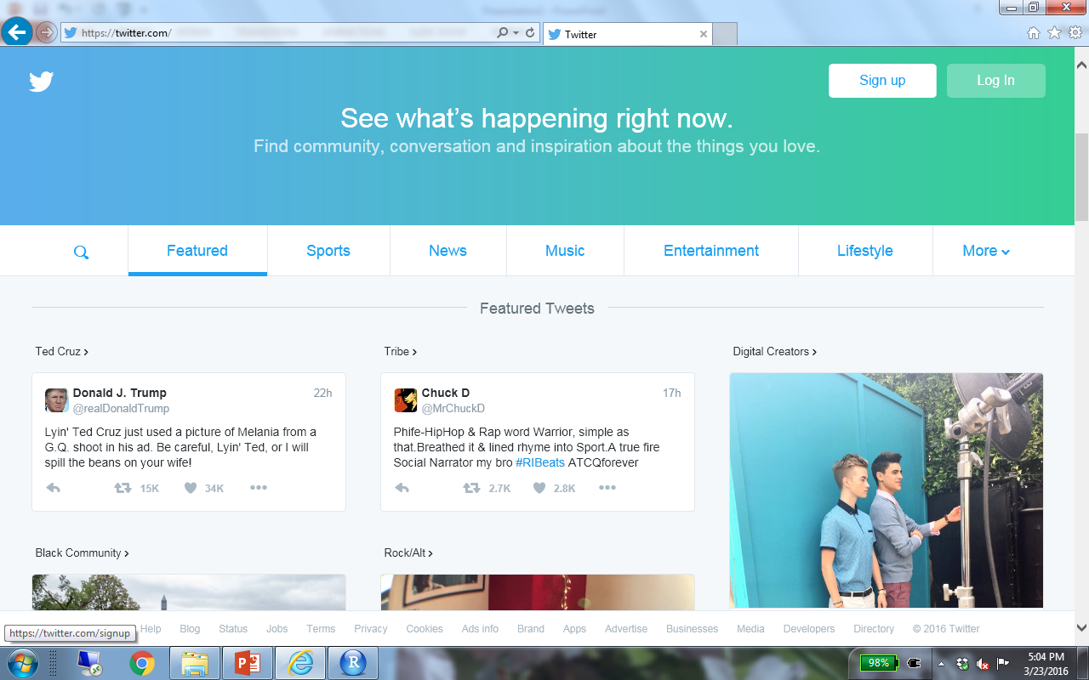

Slide 3
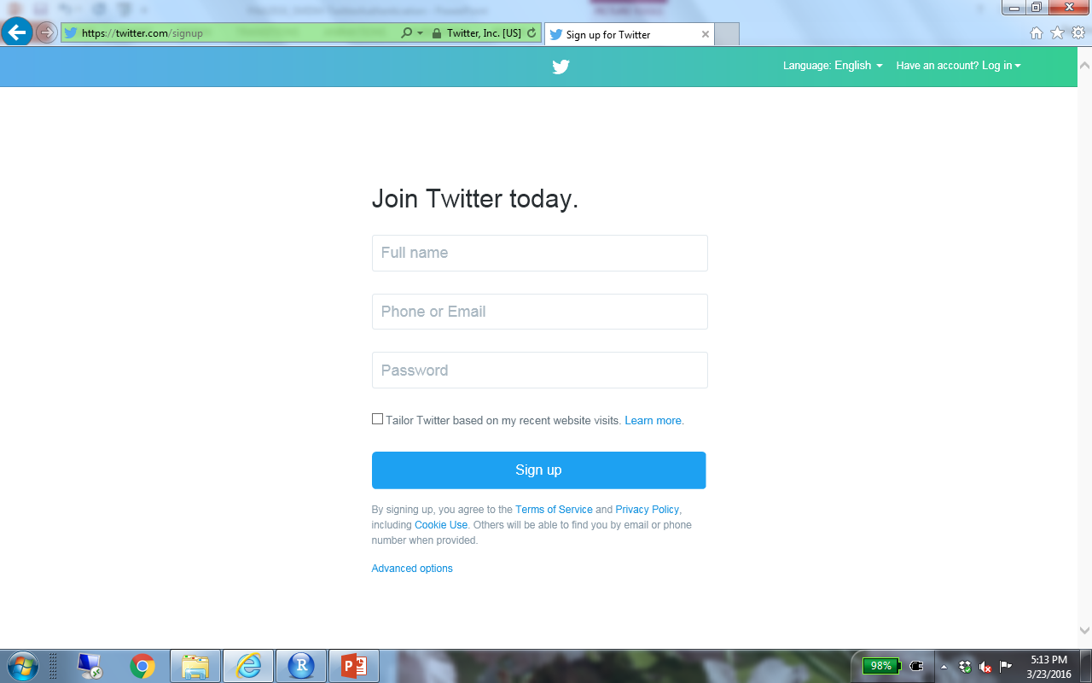

Slide 4
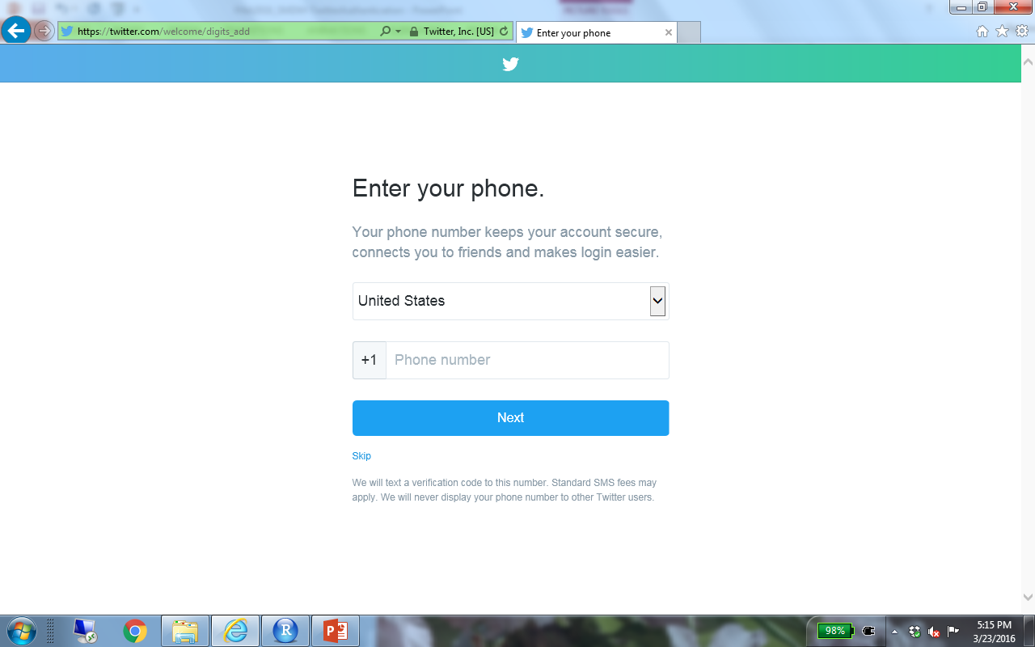

Slide 5
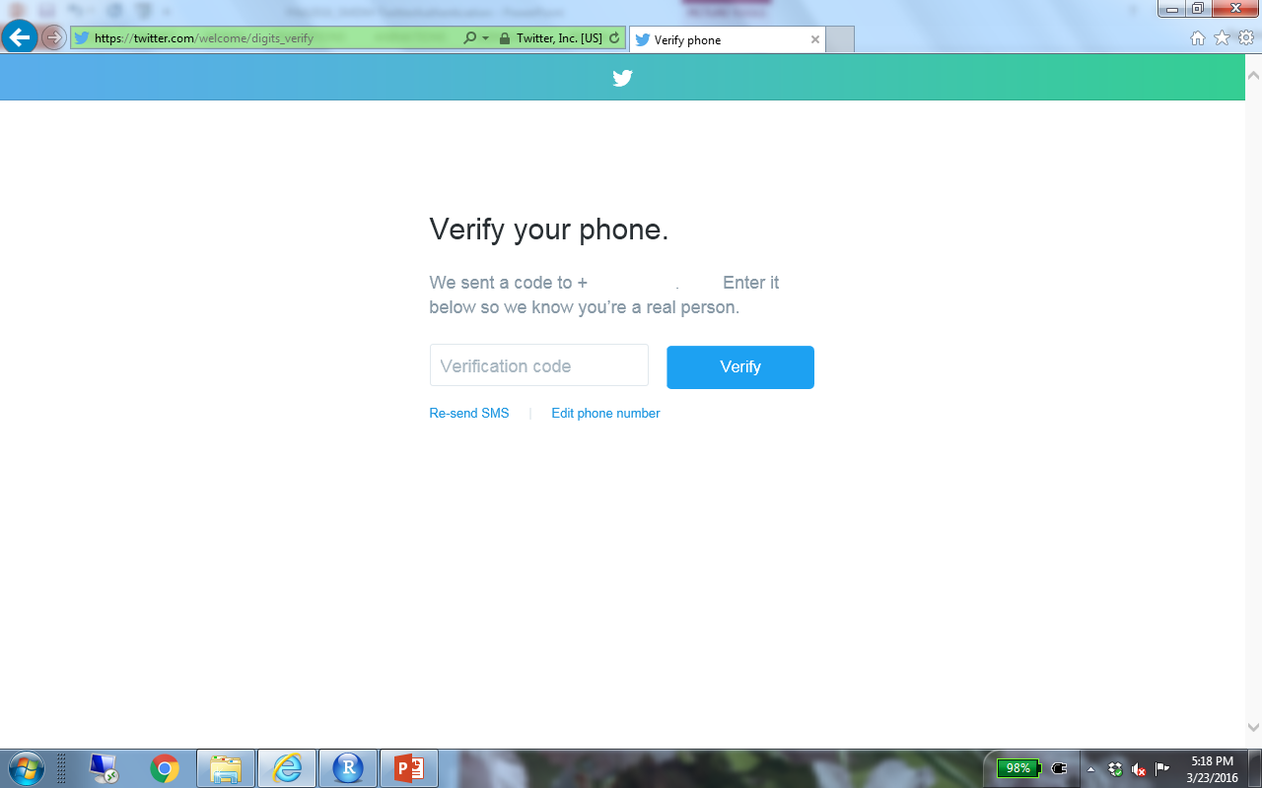

Slide 6
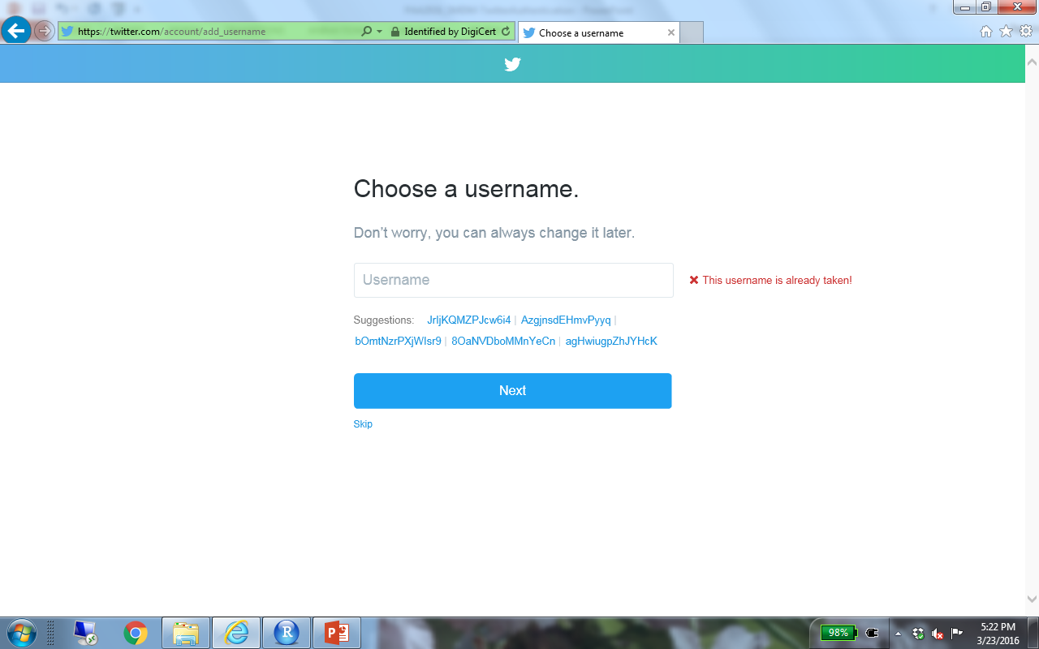

Slide 7
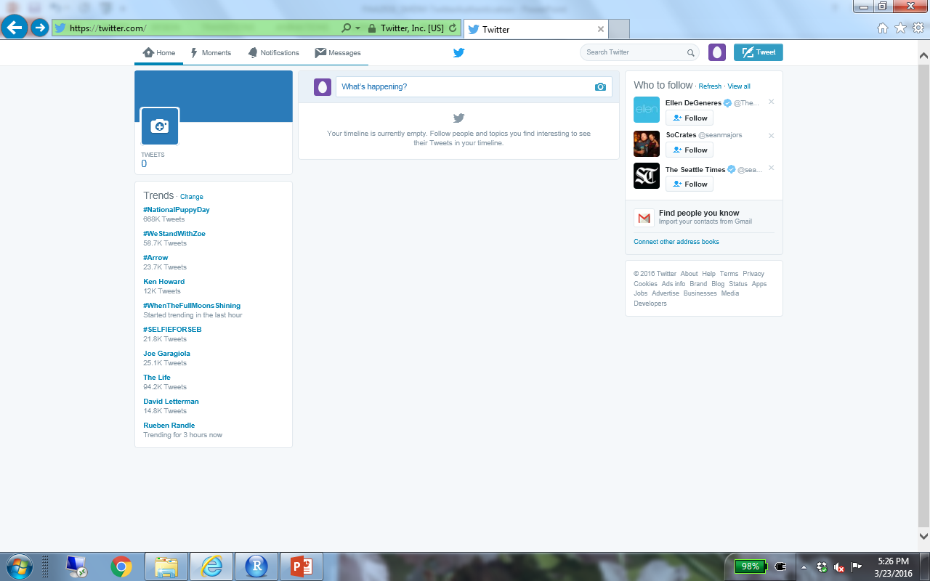

Slide 8
Go to the twitter developers’ page (dev.twitter.com) to create an app
Go to “Manage my apps”
Create a new app (it can have any name and you can use any website,
as long as you include the full Web address (staring with http://).
Leave the “callback URL” empty.
The following slides show the screenshots

Slide 9


Slide 10
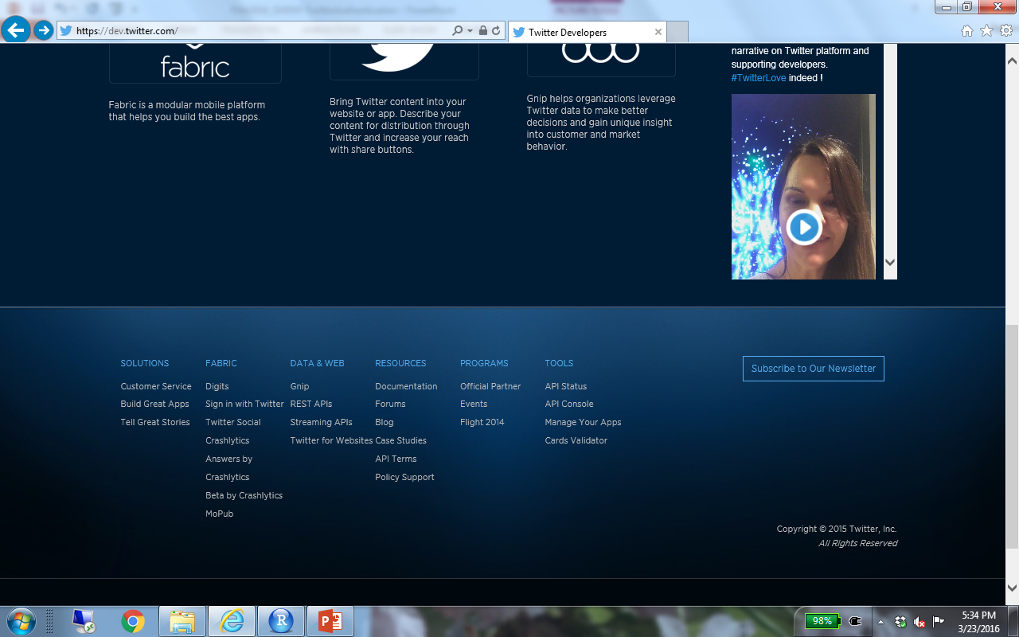

Slide 11
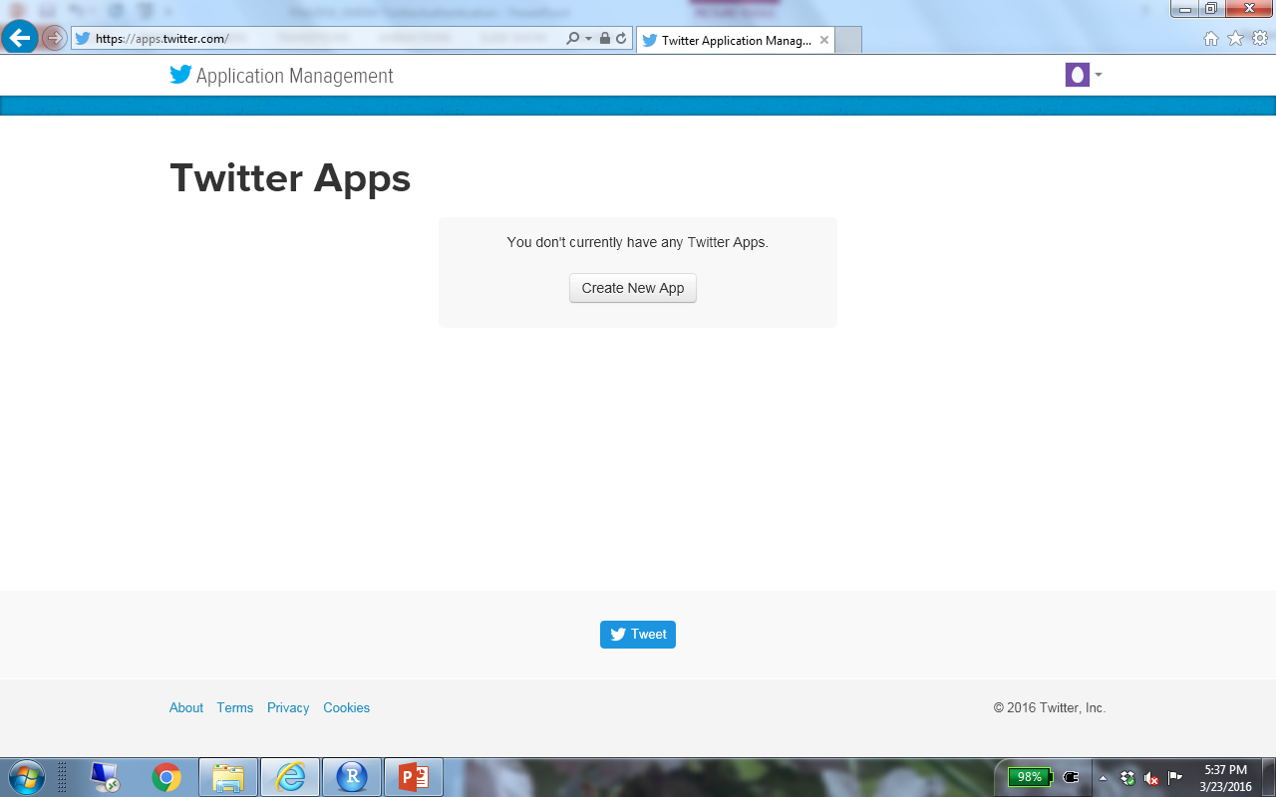

Slide 12
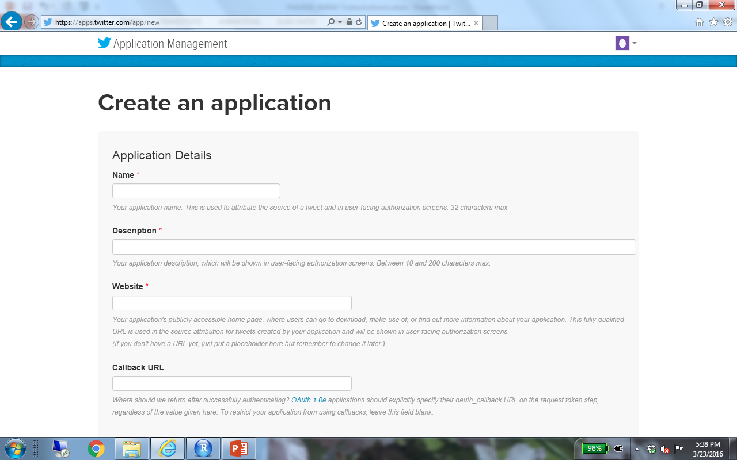

Slide 13
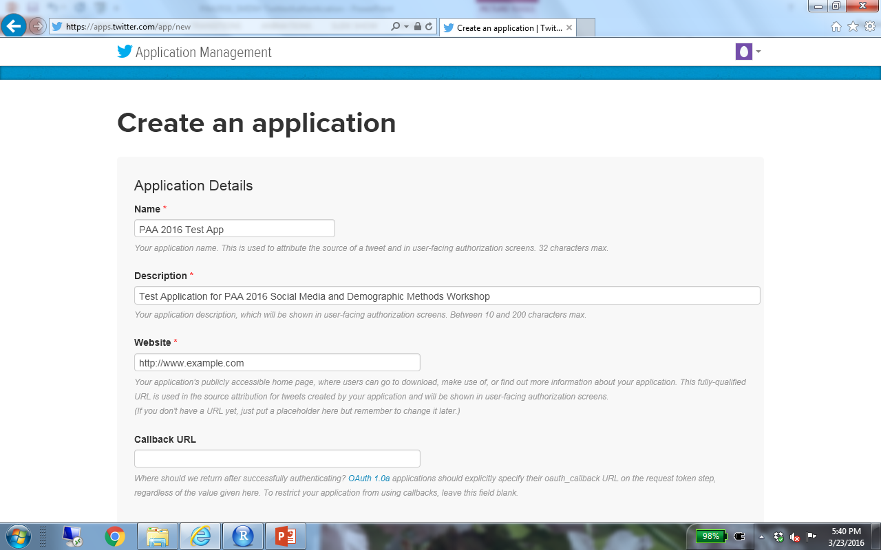

Slide 14
Use the appropriate tab to find the “consumer key” and “the consumer secret” > copy and paste those strings somewhere as we will need them
Then create the your access tokens and copy and paste the “Access Token” and “Access Token Secret” somewhere, as we will need them.
The following slides show the screenshots for the steps

Slide 15
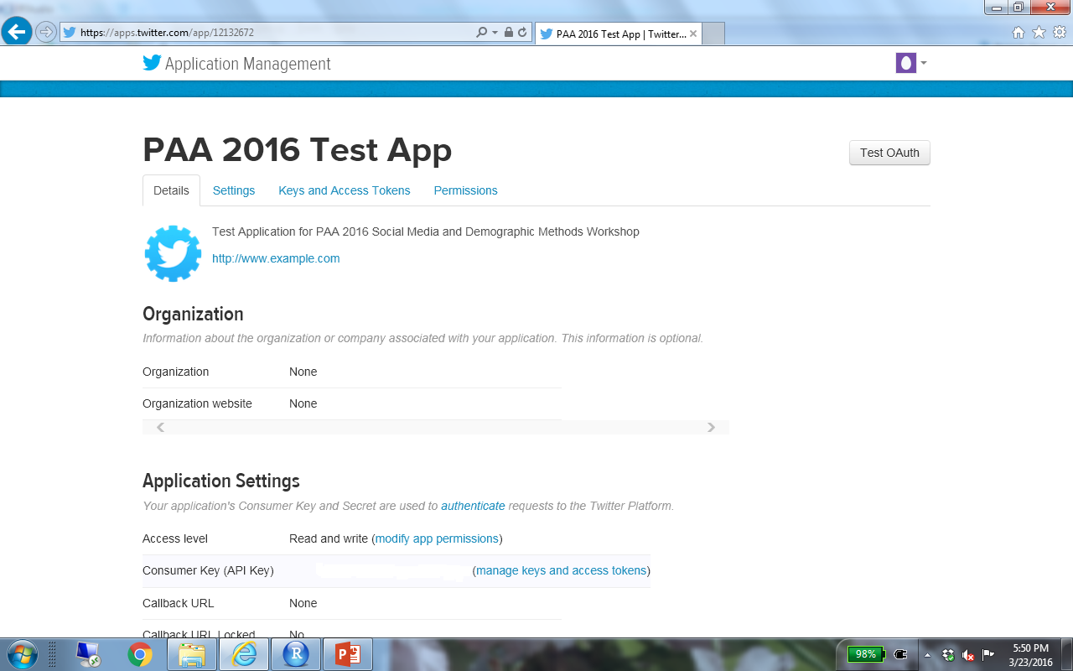

Slide 16
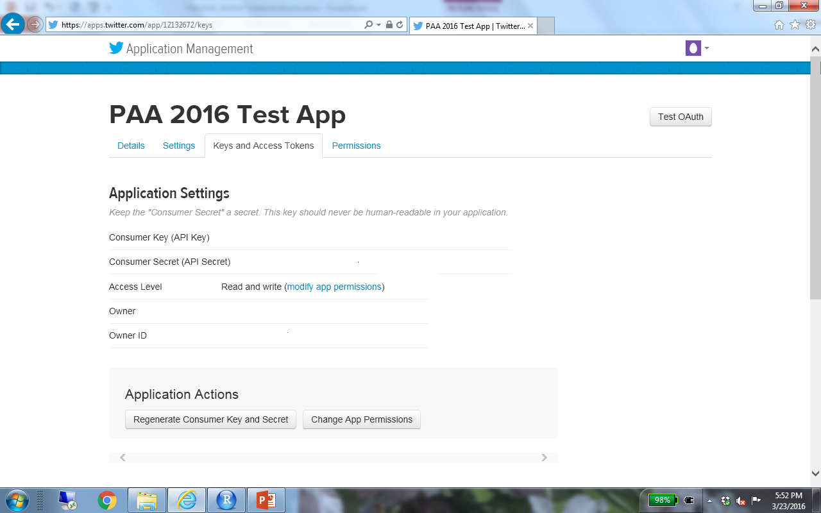
Copy Consumer Key and Consumer Secret
Scroll down to generate tokens

Slide 17
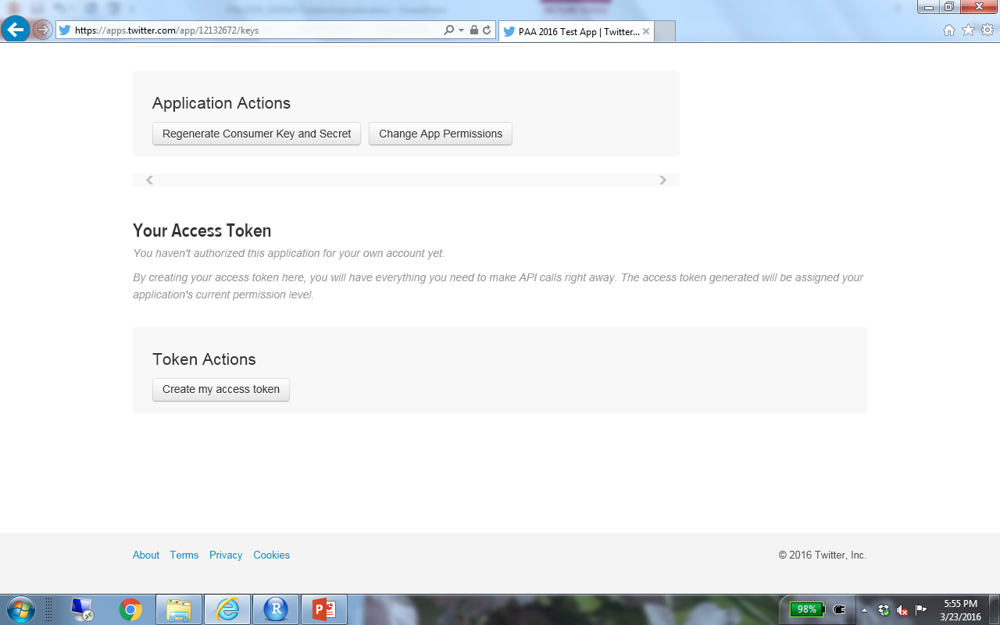

Slide 18
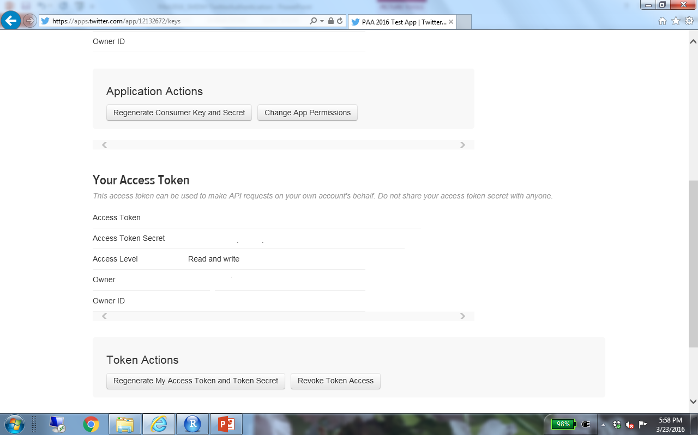
Copy Access Token and Access Token Secret

